Slide 1
Huricane Harvey – Best Track Analysis
Data Analytics & Visualization 2020

Slide 2
Project Information
Project Team (Group 6): Reza Abasaltian, Vincent Adams, Jeremy Jones, & Rob Pascarella
Project Scope: As a group we have decided to gather data from offshore weather stations and platforms to perform an analysis of weather attributes as they correlate to the intensity of Hurricane Harvey.
For the timeframe of the project we chose the attributes below:
Wind Speed
Water Salinity
Air Pressure
Water Temperature
Air Temperature
Question: What factor contributes the most to the final path of the Hurricane?

Slide 3
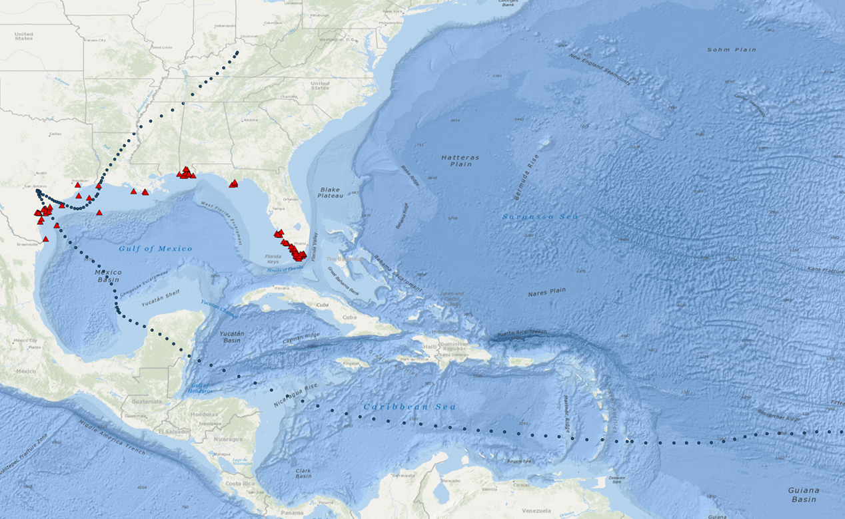
Project Data
Data Retrieval:
CSV
http://data.gcoos.org/waf.php
https://www.nhc.noaa.gov/data/tcr/AL092017_Harvey.pdf
Took data created a csv for best track
API
ArcPy

Slide 4
Project Data Points Location
Final Data Points:
42043
42044
42047
8764314
8770613
TABS-X

Slide 5
Water Temperature

Slide 6
Water Salinity

Slide 7
Air Temperature

Slide 8
Air Pressure

Slide 9
Wind Speed

Slide 10
Conclusions

Slide 11
Findings

Slide 12
Questions

Slide 13


